Slide 1
Aggregate Demand and Aggregate Supply
Ravi Kiran

Slide 2
Aggregate Demand
Aggregate demand is the relationship between the total quantity of goods and services demanded (from all the four sources of demand) and the price level, all other determinants of spending unchanged.
The aggregate demand curve is a graphical representation of aggregate demand.

Slide 3
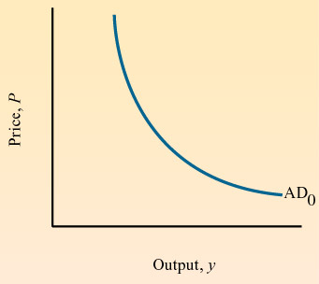
Aggregate Demand
The aggregate demand curve plots the total demand for GDP as a function of the price level.
AD = C + I + G + (X – M)
C-consumption, I-investment,
G-government spending, and net exports
(X-M)
The price level refers to the average of all prices in the economy, as measured by a price index.

Slide 4
Components of Aggregate Demand
Demand for GDP comprises the demand for goods and services by all sectors of the economy:
the household sector (consumption),
the business sector (investment),
the government sector (government spending), and
the foreign sector (net exports)

Slide 5
Aggregate Demand
Consumption can change for a number of reasons:
due to movements in income,
taxes,
expectations about future income, and
changes in wealth levels.
Investment can change in response to its expected profitability, which in turn is shaped by:
expectations about future economic growth,
the creation of new technologies,
the price of key inputs, and
tax incentives for investment.
Investment can also change when interest rates rise or fall.

Slide 6
Aggregate Demand
Government spending and taxes are determined by political considerations.
Exports and imports change according to relative growth rates and prices between two economies.
Disposable income is income after taxes.
An inflationary gap exists when equilibrium is at a level of output above potential GDP.
A recessionary gap exists when equilibrium is at a level of output below potential GDP.

Slide 7
Aggregate Demand
Aggregate demand slopes downward for several reasons. Among them are:
The wealth effect: as the price level falls, the real value of money increases and people find that they are wealthier. This concept is associated with the reality principle.
What matters to people is the real value or purchasing power of money or income, not its face value.

Slide 8
Aggregate Demand
The interest rate effect: with a given money supply, a lower price level will lead to lower interest rates and higher consumption and investment spending.
The impact of international trade: a lower price level makes domestic goods cheaper relative to foreign goods; and a lower interest rate leads to a lower exchange rate which also makes domestic goods relatively cheaper than foreign goods.

Slide 9
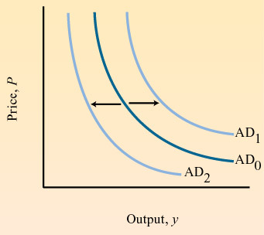
Aggregate Demand
Factors That Increase Aggregate Demand
Factors That Decrease Aggregate Demand
Decrease in taxes
Increase in taxes
Increase in government spending
Decrease in government spending
Increase in the
money supply
Decrease in the
money supply

Slide 10
Aggregate Supply Curve
The aggregate supply curve depicts the relationship between the level of prices and real GDP.
We will consider two aggregate supply curves, one corresponding to the long run (the long run aggregate supply curve), and one to the short run (the short run aggregate supply curve).

Slide 11
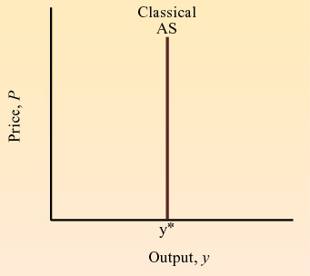
Aggregate Supply
Long Run AS
The classical aggregate supply curve is the supply curve for the long run—when the economy is at full employment.
The level of full- employment output does not depend on the level of prices, but on supply factors—
capital, labor and technology.
This is why the classical AS curve is vertical.

Slide 12
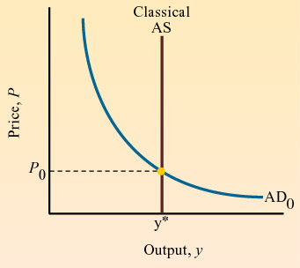
The Long Run Aggregate Supply Curve
Combined with the aggregate demand curve, the intersection of the classical AS curve and the AD curve determines the price level and the full-employment level of output.
The position of the AD curve depends on the level of taxes, government spending, and the supply of money.

Slide 13
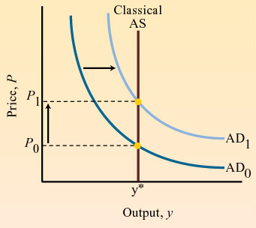
The Long Run Aggregate Supply Curve
An increase in aggregate demand does not change the level of output in the economy but only the level of prices.
The main result from the classical model is that, in the long run, output is determined solely by the supply of capital and labor—not by changes in demand.

Slide 14
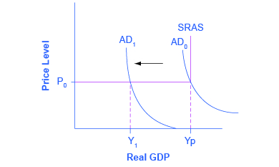
The Keynesian AD/AS model
Keynes argued that aggregate demand is not stable, it can change unexpectedly.
Suppose the economy starts where intersects SRAS at P0 and Yp in the diagram. Because Yp is potential output, the economy is at full employment.
But because aggregate demand is volatile, it can easily fall. Thus, even if we start at Yp if aggregate demand falls, we find ourselves in what Keynes termed a recessionary gap.
The economy is in equilibrium but with less than full employment, as shown at Y1.
Keynes believed that the economy would tend to stay in a recessionary gap, with its attendant unemployment, for a significant period of time.

Slide 15
Inflationary Gap
Similarly, if aggregate demand increases, the economy could experience an inflationary gap, where demand is attempting to push the economy past potential output. As a consequence, the economy would experience inflation.
The key policy implication for either situation is that government needs to step in and close the gap, increasing spending during recessions and decreasing spending during booms, to return aggregate demand to match potential output.

Slide 16
Multiplier
The name “multiplier” comes from the finding that each dollar change in exogenous expenditures (such as investment) leads to more than a dollar change (or a multiplied change) in GDP.
The key assumptions underlying the multiplier model are:
wages and prices are fixed and
there are unemployed resources in the economy.

Slide 17
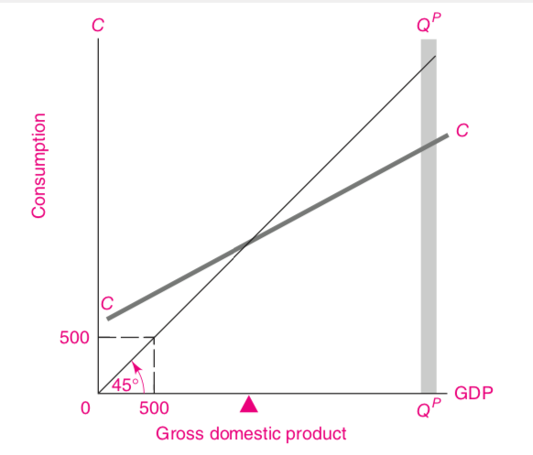
CC shows the level of consumption expenditures corresponding to every level of income (where income equals GDP in this simple example).
The two points marked “500” emphasize the important property of the 45° line.
Any point on the 45° line depicts a vertical distance exactly equal to the horizontal distance.
QPQP shows the level of potential GDP.
Figure 1: National Income Determines the Level of
Consumption

Slide 18
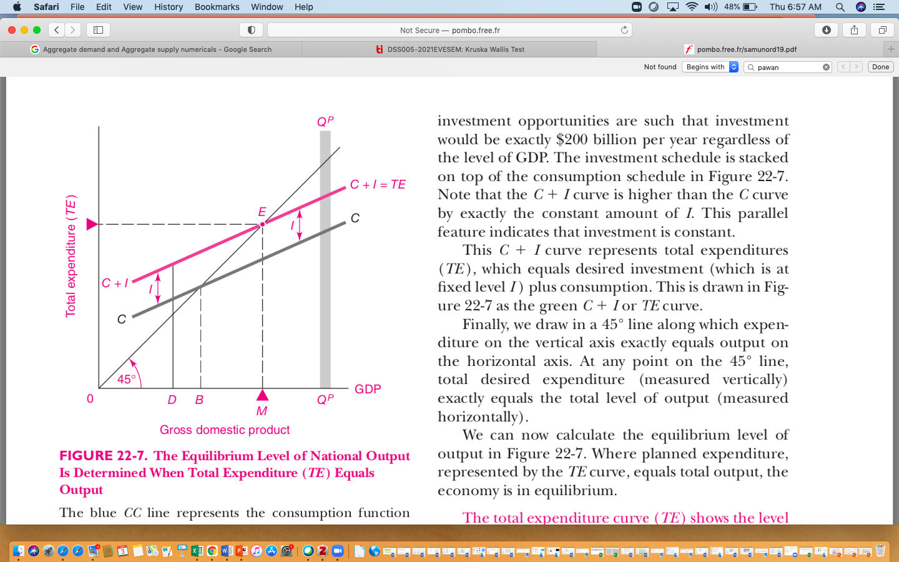
CC represents the consumption function (shown The II indicate constant investment.
Adding II to CC gives the TE curve of total desired investment plus consumption spending. Along the 45° line, expenditures exactly equal GDP.
Equilibrium GDP comes at point E, which is the intersection of the TE line and the 45° line.
This is the only level of GDP at which the desired spending on C + I exactly equals output.
At any point on the 45° line, total desired expenditure (measured vertically) exactly equals the total level of output (measured horizontally).
Equilibrium Level of National Output Is Determined When Total Expenditure (TE) Equals Output

Slide 19
Multiplier
The multiplier is the impact of a 1-dollar change in exogenous expenditures on total output.
In the simple C + I model, the multiplier is the ratio of the change in total output to the change in investment.
Multiplier is the change in output per unit change in exogenous expenditures.
This indicates that we are taking certain components of spending as given outside the model.

Slide 20
Multiplier
MPC=2/3 | 1000 | 1000
 |  | 666.6666667
 |  | 444.4444444
 |  | 296.2962963
 |  | 197.5308642
 |  | .......3000
The size of the multiplier thus depends upon how large the MPC is. It can also be expressed in terms of the twin concept, the MPS. For a MPS of 1⁄4, the MPC is 3⁄4 and the multiplier is 4. For a MPS of 1⁄3, the multiplier is 3. If the MPS were 1/x, the multiplier would be x.
Multiplier= 1/ (1-MPC)
Multiplier = 1/(1-2/3)
Multiplier =3

Slide 21
Multiplier
In the case in hand, the exogenous component is investment.
The same approach can be used to determine the effect of changes in government expenditures, exports, and other items on total output.
Suppose investment increases by $100 billion.
If this causes an increase in output of $300 billion, the multiplier is 3. If, instead, the resulting increase in output is $400 billion, the multiplier is 4.

Slide 22
Marginal Propensity to Consume (MPC)
The fraction of any change in disposable income that is consumed.
MPC= Change in Consumption
Change in Disposable Income
MPC = ^{ΔC}/_{ΔDI}

Slide 23
Marginal Propensity to Save (MPS)
The fraction of any change in disposable income that is saved.
MPS= Change in Savings
Change in Disposable Income
MPS = ^{ΔS}/_{ΔDI}

Slide 24
Marginal Propensities
MPC + MPS = 1
.: MPC = 1 – MPS
.: MPS = 1 – MPC
People either consume their disposable income or save it!

Slide 25
The Spending Multiplier Effect
An initial change in spending (C, I_{G}, G, X_{N}) causes a larger change in aggregate spending, or Aggregate Demand (AD).
Multiplier = Change in AD
Change in Spending
Multiplier = ^{Δ AD}/_{Δ C, I, G, or X}

Slide 26
Spending Multiplier
Y = C + I, where C = a + bY
Y = a + bY + I ……………………..(1)
Suppose I changes by ΔI such that Y changes by ΔY. The new equilibrium is:
Y + ΔY = a + b(Y + ΔY) + I + ΔI
Y + ΔY = a + bY + bΔY + I + ΔI……………..(2)

Slide 27
Spending Multiplier
Y = a + bY + I………………………………….(1)
Y + ΔY = a + bY + bΔY + I + ΔI………………(2)
ΔY = bΔY + ΔI
ΔY - bΔY = ΔI
(1 – b )ΔY = ΔI
ΔY = [ 1/(1 – b )] ΔI
ΔY/ ΔI = [ 1/(1 – b )]
ΔY/ ΔI = 1/(1 – MPC ) = 1/ MPS

